Slide 1
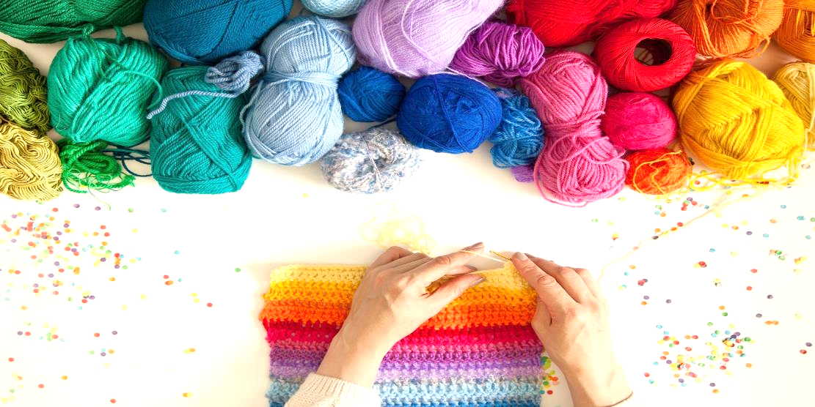

Yarn Town Workshops
Presented by Yarn Town Craft Store
Notes:
This file created specifically for Mark Mensah

Slide 2
Our Workshops
Two-Hour Workshops
Held Monthly
Focused on a Different Craft Each Month

Slide 3
Upcoming Workshops
Knitting
Aran Sweaters
Crocheting
Needlecraft
Socks
Hats & Scarves
Embroidery

Slide 4

Knitting Workshops
Limited to 8 people
Places available on a first come, first served basis
Includes the basics: cast on, knit, purl, cast off
Introduces stitch patterns & cabling

Slide 5

Crochet Workshops
Limited to 8 people
Places available on a first come, first
served basis
Beginners: cast on, basic
stitches, easy projects
Advanced: shapes, expert stitches

Slide 6
Workshop Attendees

Slide 7
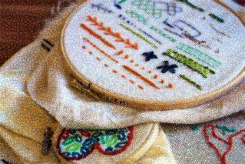
Needlework Workshops
Variety of needlework crafts featured
Expert instruction
Framing advice provided
All Levels Welcome

Slide 8
Workshops by popularity

Slide 9
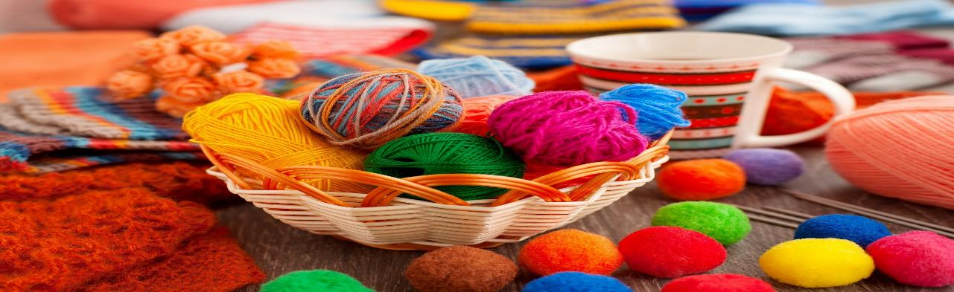
Get Crafty!

